Slide 1

Logical Operators

Slide 2
Logical Operators
The logical operators are used to perform logical operations on Boolean values.
Gives True or False as the result.
Following are the logical operators
and
or
not

Slide 3
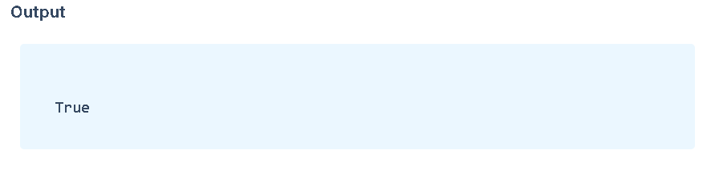
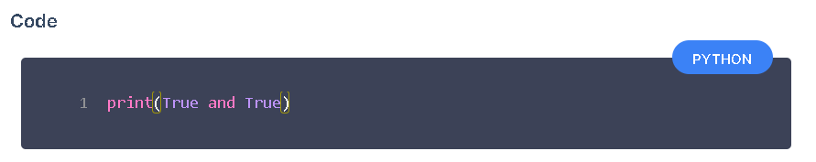
Logical AND Operator
Gives True if both the booleans are true else, it gives False

Slide 4
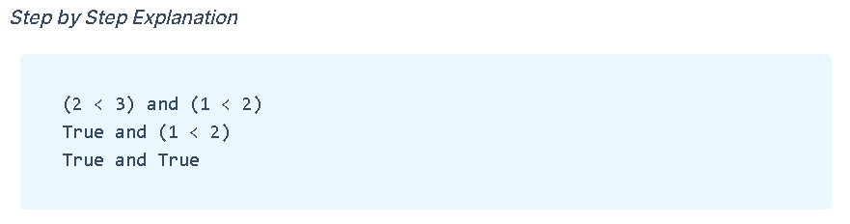
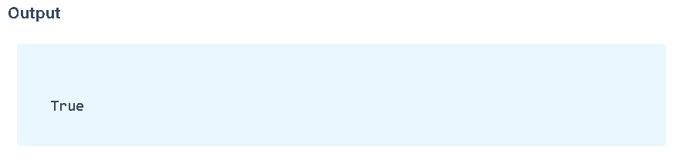
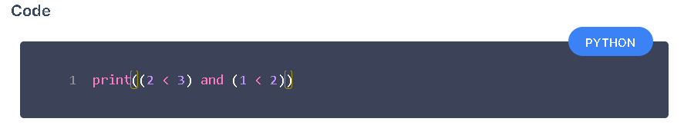
Examples of Logical AND

Slide 5

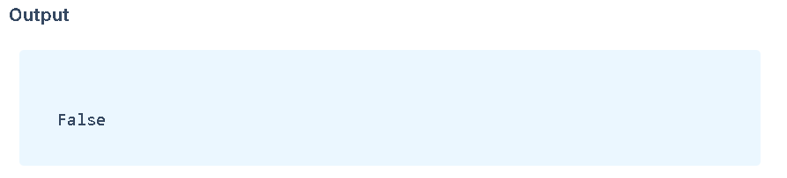
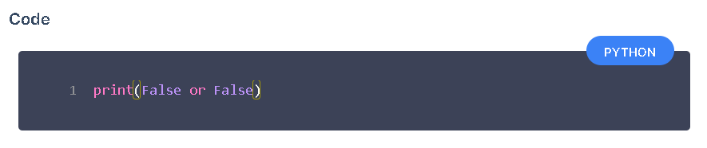
Logical OR Operator
Gives True if any one of the booleans is true else, it gives False

Slide 6
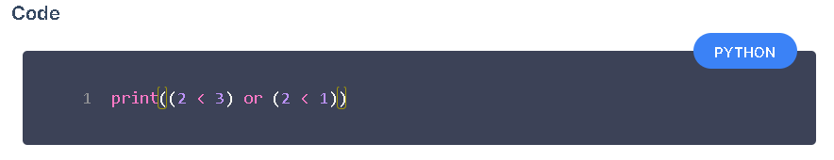
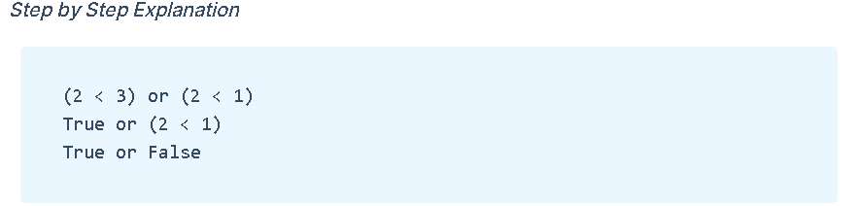
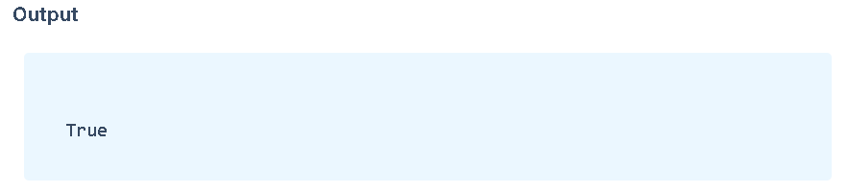
Examples of Logical OR

Slide 7
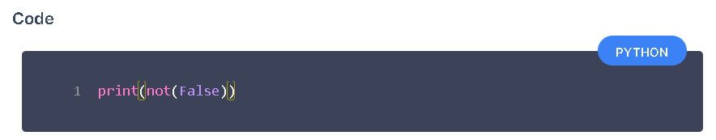
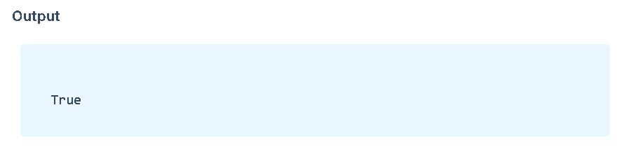
Logical NOT Operator
Gives the opposite value of the given boolean.

Slide 8
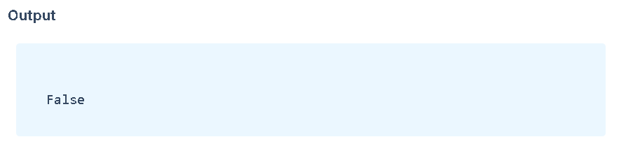
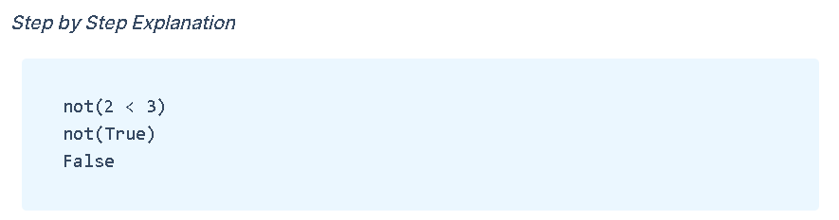
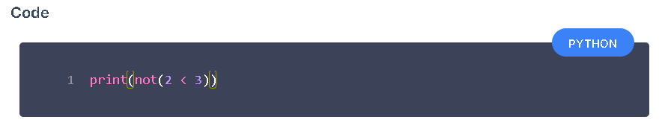
Examples of Logical NOT

Slide 9
Note
Logical AND Operator gives True if all the booleans are true.
Logical OR Operator gives True if any of the booleans are true.
Logical NOT Operator gives the opposite value

Slide 10

Conditional Statements

Slide 11

Block of Code
A sequence of instructions are called block of code.
Python executes code in a sequence.

Slide 12

Condition
An expression that results in either True or False
Examples
i. 2 < 3 ii. a == b iii. True

Slide 13
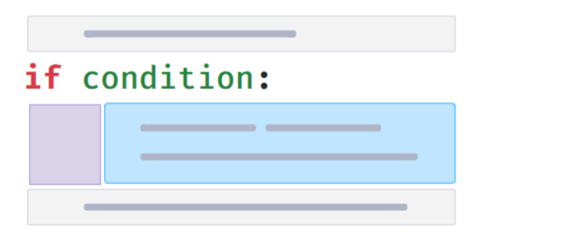
Conditional Statement
Conditional Statement allows you to execute a block of code only when a specific condition is True

Slide 14
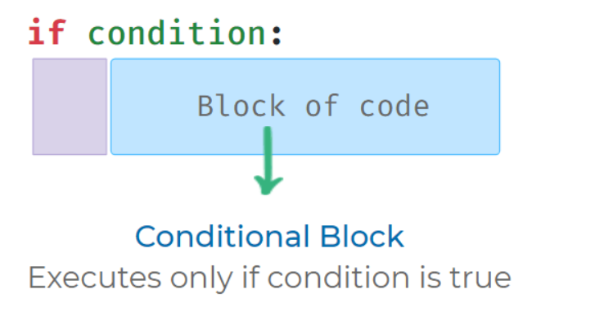
Conditional Block
Block of code which executes only if a condition is True is called Conditional Block.

Slide 15
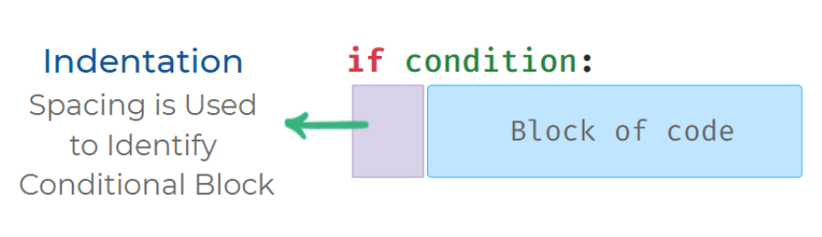
Indentation
Space(s) in front of the conditional block is called indentation.
Indentation(spacing) is used to identify Conditional Block.
Standard practice is to use four spaces for indentation.

Slide 16
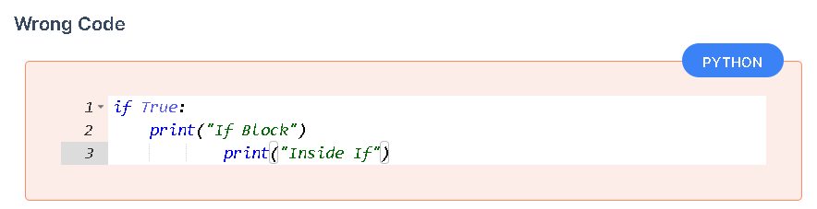
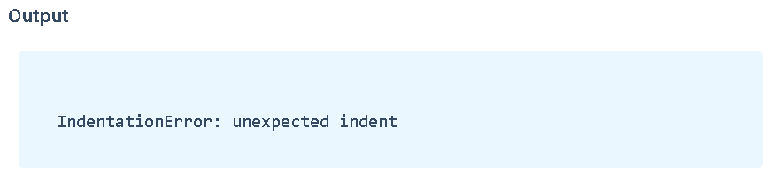
Possible Mistakes
Each statement inside a conditional block should have the same indentation (spacing).

Slide 17
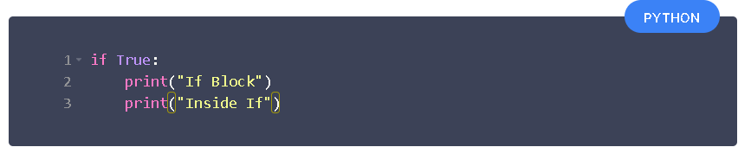
Correct Code

Slide 18
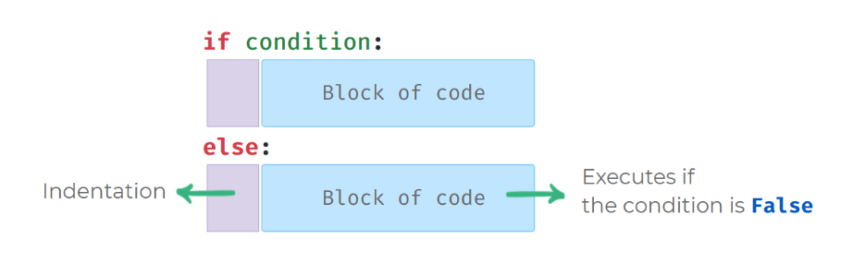
If - Else Syntax
When If - Else conditional statement is used, Else block of code executes if the condition is False

Slide 19
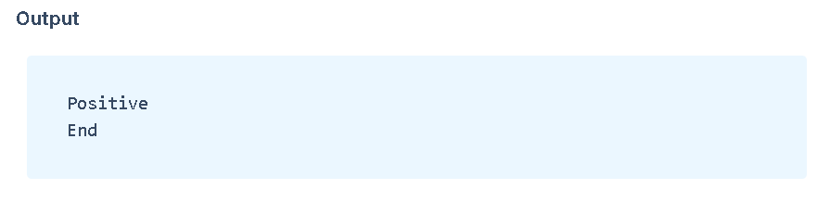
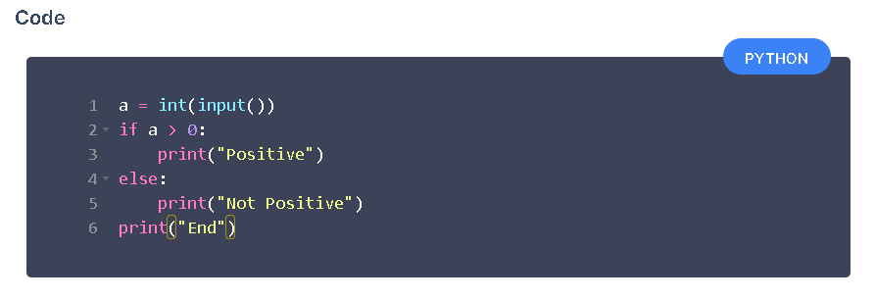
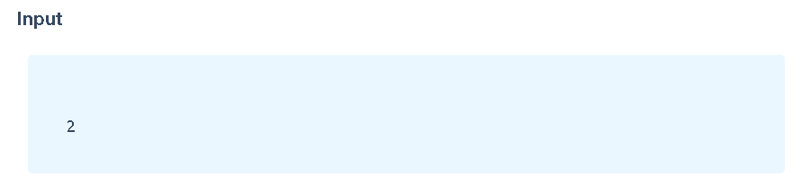
Using If-Else

Slide 20
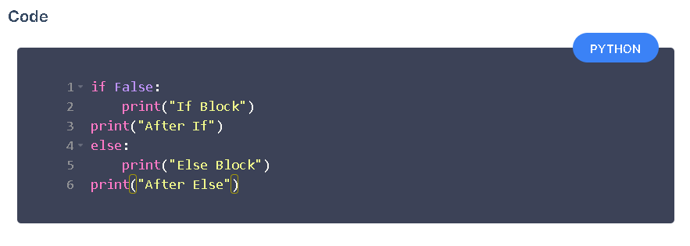
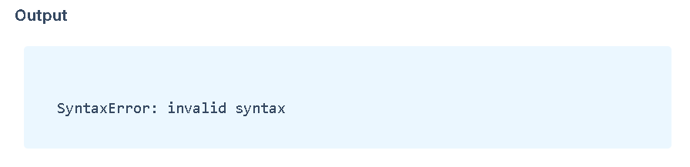
Possible Mistakes in If-Else
Else can only be used along with if condition. It is written below if conditional block

Slide 21
